Slide 1
Natural Language Processing
Parsing as Recognition (CYK parser)
Cody Valle, Sebastian Vargas, Jinous Esmaeili

Slide 2

Overview
What is CKY Algorithm
What we did
Algorithm
Completed Parser
Testing
Challenges
Extra Screenshots

Slide 3
What is CYK Algorithm?
The membership problem of context free grammars:
Given a context-free grammar G and a string u, is u in L(G)?
CKY algorithm employs a bottom-up approach to determine the derivability of string.
The algorithm produce derivations of string in L(G), that is, to be a parser.
Notes:
The CYK algorithm checks if a string can be derived from a context free grammar

Slide 4
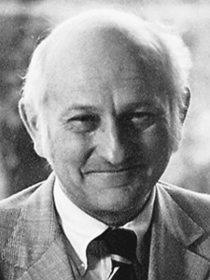

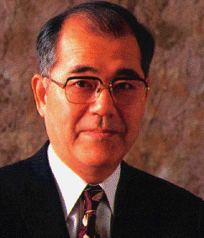
CYK Trivia!!!
The CYK parser was invented independently by three different people! John Cocke, Daniel Younger, and Tadao Kasami
Notes:
This wont be on slides “PAY ATTENSION” CKY is also known as CYK

Slide 5

What We Did
Understand the algorithm
Gather Chomsky context free grammar in a grammar.txt file
Create string.txt file that contains the string to be parsed
Implemented the CYK parser in Python
Notes:
We learned how the algorithm works
We created 2 files. One of them has the rules for the grammar in Chomsky normal form, and the other one holds the input
Then we wrote the program
Cody will talk about the algorithm in the next slide

Slide 6
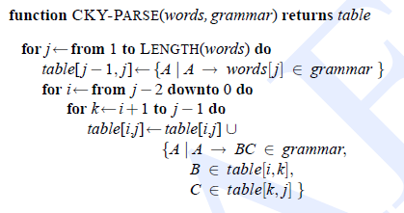
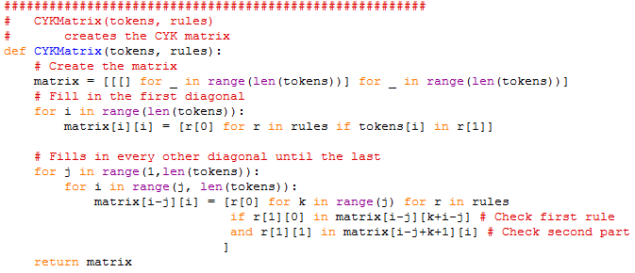
Algorithm
The CKY algorithm:

Slide 7
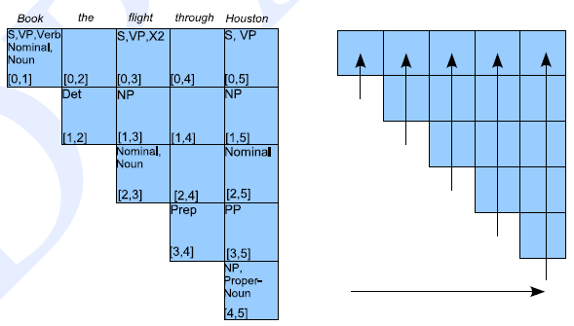
Completed Parser
Completed parse table for “Book the flight through Houston”

Slide 8
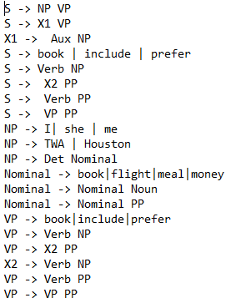
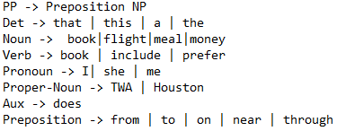
The Grammar

Slide 9

Testing
Tested our code with hand and code.
“Book the flight through Houston”
Answer was Yes
“Prefer from meal through Houston”
Answer was No
“Include that meal near TWA”
Answer was Yes

Slide 10
Challenges
While easy, it wasn’t always.
Putting the matrix into a table
Installing tabulate through the command line
Didn’t read the instructions at first
Didn’t work at all
Checked the book, got an idea of what to do
Worked for the sentence, but not others in the grammar
Checked the book again, should have read it in the beginning

Slide 11
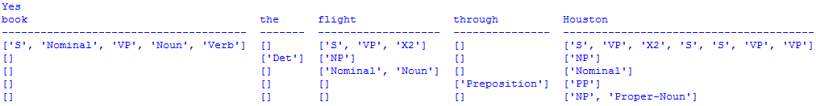
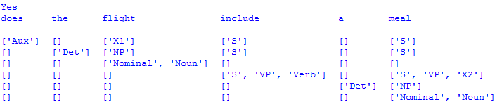
Extra Screenshots!

Slide 12
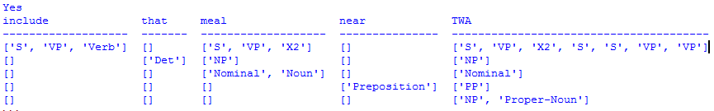
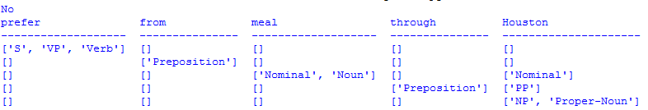
Extra Screeenshots!

